Slide 1
PRO MOVE schools & students
RESULTS

Slide 2
TEACHERS

Slide 3
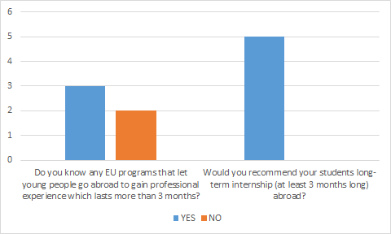
DP teachers

Slide 4
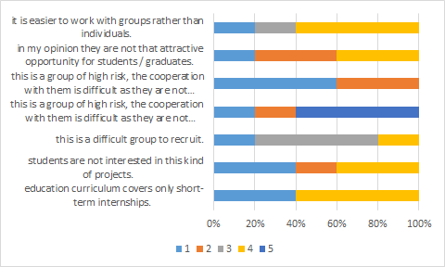
The reason why we do not organize long-term internships for students is because...
1- strongly disagree 2-somewhat disagree 3-have no opinion 4- somewhat agree 5- strongly agree

Slide 5
Is there any other reason that you think is influential in term of lack of interest in long-term internships among schools?
Answers :
-Education is only a few years.They need the training in school.
-Schools do not get paid for students that already graduated. If they send them abroad after they finish their studies it will cost the school time and formation and they will not receive any funding from the student or the government. In short it costs them a lot of time and money.
-Financial reasons.
-No, I don't think so
-No, wait yes financial reasons

Slide 6
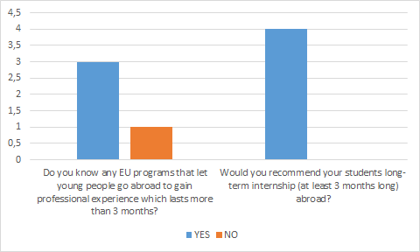
SEMPER teachers

Slide 7
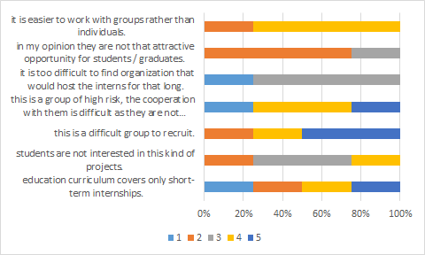
The reason why we do not organize long-term internships for students is because
1- strongly disagree 2-somewhat disagree 3-have no opinion 4- somewhat agree 5- strongly agree

Slide 8
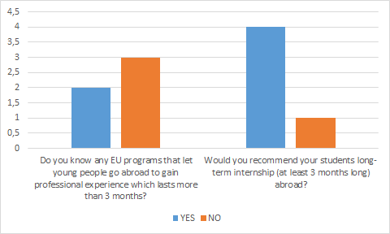
ZNI teachers

Slide 9
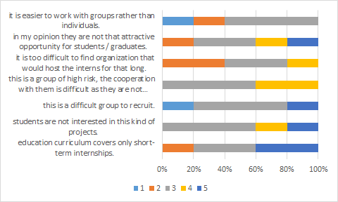
The reason why we do not organize long-term internships for students is because
1- strongly disagree 2-somewhat disagree 3-have no opinion 4- somewhat agree 5- strongly agree

Slide 10
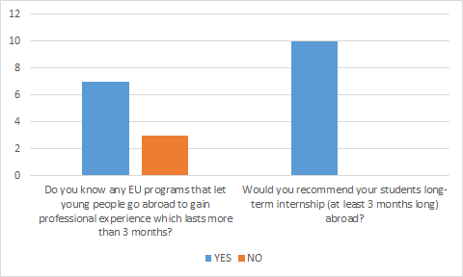
FORTES teachers

Slide 11
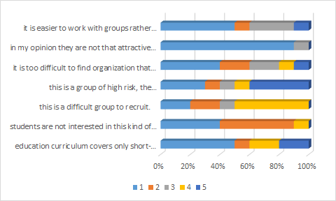
The reason why we do not organize long-term internships for students is because
1- strongly disagree 2-somewhat disagree 3-have no opinion 4- somewhat agree 5- strongly agree

Slide 12
Is there any other reason that you think is influential in term of lack of interest in long-term internships among schools?
Lack of interest from teachers and direction of the school
find an internship in which students can really put into practice the professional skills matured. This is easier if the student has completed a professional course, but difficult enough if the student has attended a technical institute, especially if it is a commercial one.
For students the interruption of regular school activity and the fear of not being able to reintegrate with studies at the end of the internship. Distance from family and friends.On the other hand, as far as new-graduted students are concerned, the most reliable and deserving students are oriented towards university studies and immediately receive attractive job offers; the others try to enter the world of work and are hardly willing to invest in their future through participation in training courses. Even if supported by European projects."
The structures of the schools have long been in difficulty in carrying out their ordinary institutional activities and do not have the resources to support further work for post-curricular activities, moreover related to people who no longer fit within the institutional framework of the Institutes.
The only reason is the organizational difficulties (finding partners and accommodation, logistics) that, however, with a technical partner like Fortes could be overcome, since the interest is present from the students.
They are considered too long, because in Italy, education is more focused on the theory than on the development of skills, and teachers are obsessed with the development of the programs.

Slide 13
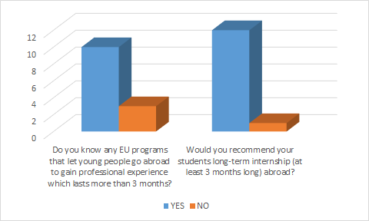
GEB teachers

Slide 14
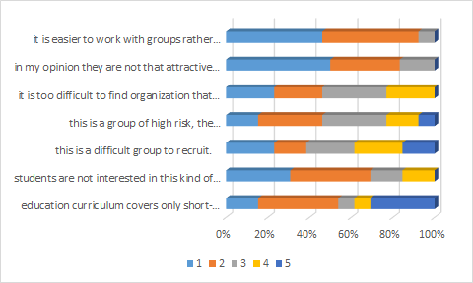
The reason why we do not organize long-term internships for students is because
1- strongly disagree 2-somewhat disagree 3-have no opinion 4- somewhat agree 5- strongly agree

Slide 15
Is there any other reason that you think is influential in term of lack of interest in long-term internships among schools?
Most of them strat their jobs directly after their final exams. They want to earn money and get involved in the normal workplaces.
the students love troubles affording their stay abroad and want to earn money
Boss is not open, to much tasks
We are planning to organize long internships
Students want to earn money as soon as possible
Students are working during their studies and after graduation they usually keep working in the same school where they did their long internship.

Slide 16
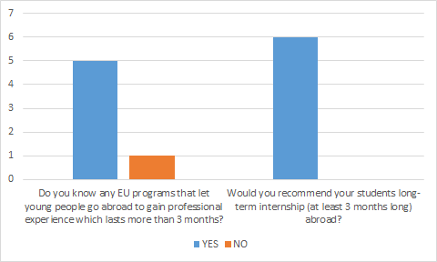
STEP teachers

Slide 17
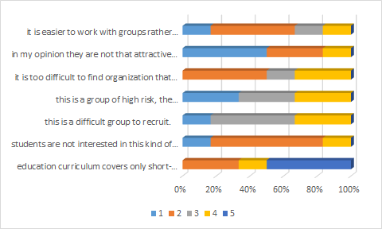
The reason why we do not organize long-term internships for students is because
1- strongly disagree 2-somewhat disagree 3-have no opinion 4- somewhat agree 5- strongly agree

Slide 18
Is there any other reason that you think is influential in term of lack of interest in long-term internships among schools?
Lack of information about practical training abroad
the lack of time for the teachers to organize this kind of programmes and the large amount of paperwork necessary to its management
this kind of programmes are not known by the students who have finished their studies and aren't in the vocational school any more
I think it is for financial matters: accommodation, subsistence, local transport…

Slide 19
STUDENTS

Slide 20
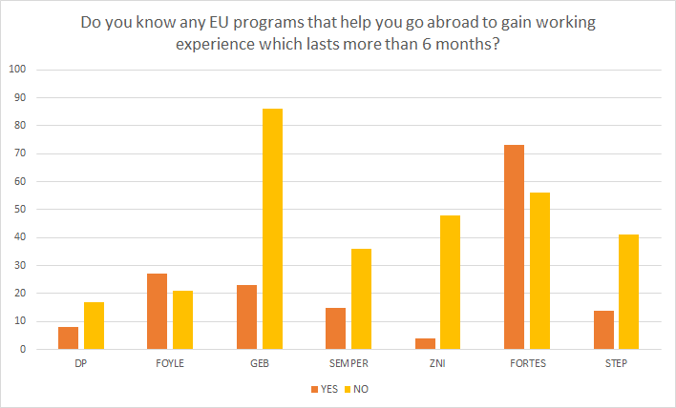

Slide 21
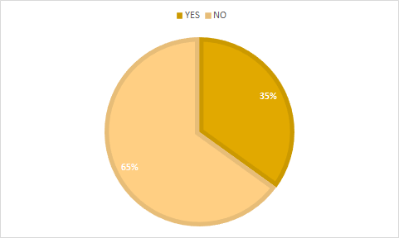

Slide 22
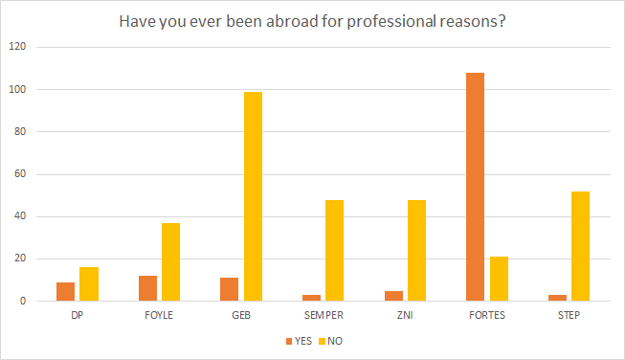

Slide 23
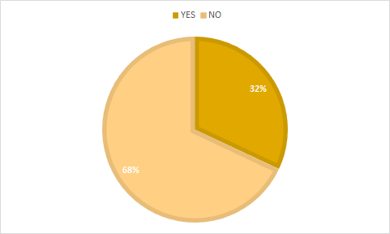

Slide 24
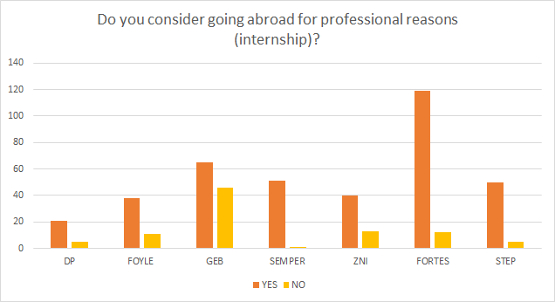

Slide 25
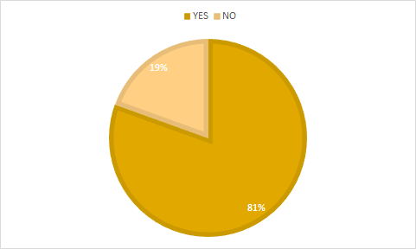

Slide 26
If you consider going abroad for professional reasons (internship), where would you like to go?
The most popular answers: -England -Germany -Switzerland -Netherlands -Spain
-Island -USA -Australia -France -Italy -Japan

Slide 27
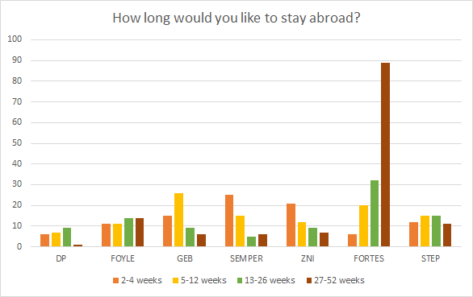

Slide 28
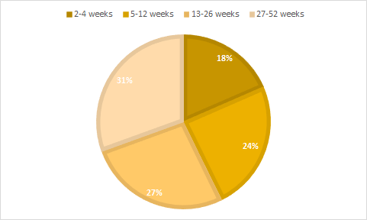

Slide 29
If you chose to go abroad for 4 weeks maximum, what keeps you from going for a longer time? You can choose more than one option.
Answers in the order from most common to rarest : -Family -Financial issues -Language skills -Friends -Professional skills

Slide 30
You decided to go for a longer time abroad. What are your questions or fears? (language skills)
Answers in the order from most common to rarest : -I only want to go if there is a language course -I only want to go to a country, when I already know the language -I only know my mother tongue

Slide 31
You decided to go for a longer time abroad. What are your questions or fears? (professional skills)
Answers in the order from most common to rarest : -I am afraid work will be too difficult -I won't manage it -I think I am too experienced - I am afraid I won't learn anything new -I never worked before - I am afraid I can't do it

Slide 32
You decided to go for a longer time abroad. What are your questions or fears? (structural obstacles)
-Accommodation -What if job doesn't fit with my study -I think i don't feel well at work -I will lost a contact with my friends -fear of being alone abroad -My boss wouldn´t allow me, I could lose my job. And I will have difficulties to pay my apartment every month -not enough financial support

Slide 33
Do you have any suggestions to improve young people's interest in medium or long-term European mobility?
-Trying to reduce to the maximum the financial contribution from the participants. Nowadays, the families have more and more economic difficulties which would not break them to help their children financially in order to allow them to have this kind of experience. -Explain the young people that there is another world beside their own one. That it is really important to be confronted to it, to discover other realities to open their mind. -Giving more importance to learning foreign languages and cultures. -Motivate the schools to talk more about the mobility projects and organize more mobility projects to students. -Being careful to send people to countries who also speak well English not only their native language. -to propose a free program, or with a big financial support

Slide 34
Thank you for your attention

